Slide 3
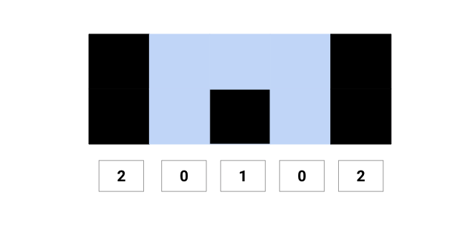
Example 1
Input: height[] = [2, 0, 1, 0, 2], Output: 5 Explanation: Trapped water = 2 x 1 + 1 x 1 + 2 x 1 = 5 (Area of the blue region in the following diagram)

Slide 4
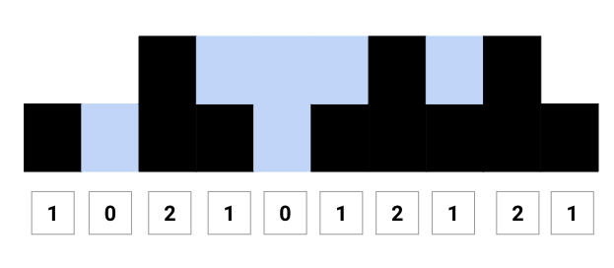
Example 2
Input: height[] = [0,1,0,2,1,0,1,3,2,1,2,1], Output: 6 Explanation: Trapped water = 1 x 1 + 1 x 1 + 2 x 1 + 1 x 1 + 1 x 1 = 6 (Area of the blue region in the following diagram)

Slide 5
BRUTE FORCE
One basic idea would be to scan the height[] array and sum the water trapped at each tower. The height of water trapped at any tower height[i] = minimum of maximum height of towers on both the sides minus its height, i.e., min (max tower height in the left, max tower height in the right) — height[i]

Slide 6
ALGORITHM STEPS
We declare and initialise the variable trappedWater to store the total trapped water.
Now scan the height[] from from i = 0 to n-1. Inside the loop, we declare and initialise the variable left_maxHeight and right_maxHeight to store the maximum height of the tower on both sides of the current tower.
For each tower height[i], we calculate the maximum height of the tower from current index i up to the left end. We store this value in the variable left_maxHeight.
for(int k = i; k >= 0; k = k - 1) { left_maxHeight = max(height[k], left_maxHeight) }For each tower height[i], we calculate the maximum height of tower from current index i up to right end. We store this value in the variable right_maxHeight.
for(int j = i; j < n; j = j + 1) { right_maxHeight = max(height[j], right_maxHeight) }Now we update the total amount of water by using the above formula.
trappedWater = trappedWater + min(left_MaxHeight, right_maxHeight) - height[i]By end of the above loop, we return the value of the variable trappedWater.

Slide 7
PSEUDO CODE
int rain_water_trapping(int height[], int n) { if(n <= 2) return 0 int trappedWater = 0 for(int i = 0; i < n; i = i + 1) { int left_maxHeight = 0 , right_maxHeight = 0 for(int k = i; k >= 0; k = k - 1) { left_maxHeight = max(height[k], left_maxHeight) } for(int j = i; j < n; j = j + 1) { right_maxHeight = max(height[j], right_maxHeight) } trappedWater = trappedWater + min(left_maxHeight, right_maxHeight) - height[i] } return trappedWater }

Slide 8
TIME AND SPACE COMPLEXITY
We are using nested loops where the outer loop is scanning the height[] array, and two inner loops are finding right_maxHeight and left_maxHeight. So every iteration of the outer loop, we are traversing each element via inner loops. Time Complexity = O(n * n) = O(n²), Space Complexity = O(1)

Slide 9
DYNAMIC PROGRAMMING
Algorithm Idea
Can we improve the efficiency further and solve the problem in O(n)? Is it possible to remove the separate inner loop for finding the left_maxHeight and right_maxHeight? Let’s think!
If the values of left_maxHeight and right_maxHeight known for every tower then we can solve this problem in a single scan of the height[i] array. But how can we do this? One idea would be to pre calculate left_maxHeight and right_maxHeight for each tower height[i] and store them in separate extra memory.
Suppose we take left[n] and right[n] to store the values where: left[i] = left_maxHeight of the tower height[i], right[i] = right_maxHeight of the tower height[i]
Can we do the pre-processing and store values in linear time? Here is an idea:
Suppose we know the value of left[i-1], then we can easily calculate the left[i] in O(1). Here is the formula => left[i] = max (left[i-1], height[i]) (Think)
Similarly, if we know the value of right[i+1], then we can easily calculate the right[i] in O(1). Here is the formula => right[i] = max (right[i+1], height[i]) (Think)
This is a dynamic programming approach where we are using the stored solution of the smaller problem to get the solution of the larger problem.

Slide 10
ALGORITHM STEPS
We create two arrays left[n] and right[n]
Now run a loop from left to right and fill the left[n] array. At every iteration i, we store the maximum element that occurred up to that point in left[i]. (Think!)
left[0] = height[0] for(int i = 1; i < n; i = i + 1) { left[i] = max(left[i-1], height[i]) }Similarly, run a loop from right to left, and fill the right[n] array. At every iteration i, store the maximum element occurred up to that point in right[i]. (Think!)
right[n-1] = height[n-1] for(int i = n-2; i >= 0; i = i - 1) { right[i] = max(right[i+1], height[i]) }Now, traverse the height[] array and calculate the total amount of water.
int trappeWater = 0 for(int i = 0; i < n; i = i + 1) { trappedWater = trappedWater + min(left[i], right[i]) - height[i] }
Return the value stored in the variable trappedWater.

Slide 11
PSEUDO CODE
int rain_water_trapping(int height[], int n) { if(n <= 2) return 0 int left[n], right[n] left[0] = height[0] for(int i = 1; i < n; i = i + 1) { left[i] = max(left[i-1], height[i]) } right[n-1] = height[n-1] for(int i = n-2; i >= 0; i = i - 1) { right[i] = max(right[i+1], height[i]) } int trappeWater = 0 for(int i = 0; i < n; i++) { trappedWater = trappedWater + min(left[i], right[i]) - height[i] } return trappedWater }

Slide 12
TIME AND SPACE COMPLEXITY
In the above pseudo code, we are running three independent loops of size n. To find right_maxHeight and left_maxHeight, we used two separate loops. And, to traverse the array, also we used one loop. So, Time Complexity = O(n) + O(n) = O(n).
We used two extra arrays of size n. So Space Complexity = O(n) + O(n) = O(n)

Slide 13
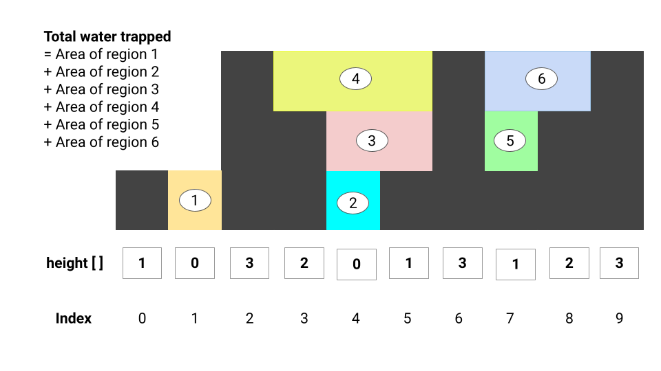
STACK
Area of region 1 = area confined between index 2 and 0
Area of region 2 = area confined between index 5 and 3
Area of region 3 = area confined between index 6 and 3
Area of region 4 = area confined between index 6 and 2
Area of region 5 = area confined between index 8 and 6
Area of region 5 = area confined between index 9 and 6

Slide 14
ALGORITHM STEPS
We declare a stack S to store the indices of the towers.
Now we scan the height[n] using a loop variable curr < n
If we found a current tower larger than that tower at the top of the stack, we can say that the tower at the top of the stack is confined between the current tower and a previous tower in the stack. Hence, we pop the stack and add water trapped between towers to the total water trapped. We can continue this step in a loop until we find the current tower smaller than the tower at the top of the stack.
Water trapped between towers = Area of the rectangular region formed by the current tower, popped tower, and tower at the top of the stack
Region length = (current index — index of the top stack element — 1)
Region height = min (height of the current tower, height of tower at top of the stack) — height of the popped tower
Water trapped = Region length x Region height
If the current tower is smaller than or equal to the tower at the top of the stack, we push the index of the current tower to the stack and move to the next tower. It means current tower is confined with tower at the top of the stack.

Slide 15
PSEUDO CODE
int rain_water_trapping(int height[], int n) { int trappeWater = 0, curr = 0 stack S while (curr < n) { while (!S.empty() && height[curr] > height[S.top()]) { int top_tower = S.Pop() if (S.empty()) break int region_length = curr - S.top() - 1 int region_height = min(height[curr], height[S.top()]) - height[top_tower] trappedWater = trappedWater + region_length * region_height } S.push(curr) curr = curr + 1 } return trappedWater }

Slide 16
TIME AND SPACE COMPLEXITY
We are doing single traversal of the height[] array. In the worst case, we are processing each tower twice using stack i.e. one push() and one pop() operation. (Think!) Both push() and pop() operations takes O(1) time in the worst case. So, time Complexity = O(n).
In the worst-case stack can take up to n elements. Space Complexity = O(n)

Slide 17
TWO POINTERS
Algorithm Idea:
In the last two approaches, we are using extra spaces to get the solution. Can we solve this problem in a single scan without using extra space? Let’s explore!
Based on the formula used in the 2nd approach, the water trapped by any tower depends on the minimum of maximum height of towers on both sides. So instead of maintaining two arrays of size n for storing left_maxHeight and a right_maxHeight, can we think to maintain two variables to store the maximum till a given point? Think!
Suppose we search from both the left and right end by maintaining two pointers left and right separately. If there is a larger tower at the right end, then the water trapped would be dependant on the tower’s height in the direction from left to right. Similarly, if the tower at the right end is smaller, then the water trapped would be dependant on the tower’s height in the direction from right to left. (Think!)
We first calculate the water trapped on smaller elements out of height[left] and height[right], then move the pointer associated with the smaller element. We move the pointers till the left doesn’t cross right. In terms of analogy, we can think of height[left] and height[right] as a wall of a partial container where we fix the higher one and flow water from the lower part.

Slide 18
ALGORITHM STEPS
We declare and Initialise left and right pointers.
Also declare and Initialise variables trappedWater, left_maxHeight and right_maxHeight.
int trappedWater = 0 int left_maxHeight = 0, right_maxHeight = 0 int left = 0, right = n - 1Now run a loop to scan the array i.e. while (left <= right)
If (height[left] < height[right]) and (height[left] < left_maxHeight), then we calculate the trapped water stored by the both towers and increase the left pointer. But if (height[left] > left_maxHeight), then we update value of left_maxHeight and increase the left pointer.
if (height[left] < height[right]) { if (height[left] > left_maxHeight) left_maxHeight = height[left] else trappedWater = trappedWater + left_maxHeight - height[left] left = left + 1 }

Slide 19
ALGORITHM STEPS
If (height[left] > height[right]) and height[right] < right_maxHeight) then we calculate the trapped water stored by the both towers and decrease the right pointer. But if (height[right] > right_maxHeight), then we update value of right_maxHeight and decrease the right pointer.
if (height[left] > height[right]) { if (height[right] > right_maxHeight) right_maxHeight = height[right] else trappedWater = trappedWater + right_maxHeight - height[right] right = right - 1 }When left > right, then we exit the loop and return the value stored in the trappedWater.

Slide 20
PSEUDO CODE
int rain_water_trapping(int height[], int n) { int trappedWater = 0 int left_maxHeight = 0, right_maxHeight = 0 int left = 0, right = n - 1 while (left <= right) { if (height[left] < height[right]) { if (height[left] > left_maxHeight) left_maxHeight = height[left] else trappedWater = trappedWater + left_maxHeight - height[left] left = left + 1 } else { if (height[right] > right_maxHeight) right_maxHeight = height[right] else trappedWater = trappedWater + right_maxHeight - height[right] right = right - 1 } } return trappedWater }

Slide 21
TIME AND SPACE COMPLEXITY
We are doing single scan to traverse the array from both ends. After each comparison, we are moving either left pointer or right pointer. So in the worst case, we need to do O(n) operations.
Time Complexity = O(n), Space Complexity = O(1), only constant space required for variables and pointers.

